Slide 1

Tic-Tac-Toe Game Project
Building a Python Game Application

Slide 2
Team Members
Revanth Paineni Sridhar Yemundla Asif Ali Mongan Shaik

Slide 3

AI for Tic-Tac-Toe Game
Welcome to our Tic-Tac-Toe Game Project presentation. In this project, we have developed a Python-based game application that brings the classic Tic-Tac-Toe game to life. Our team has designed, coded, and visualized the game.
Throughout this presentation, we will walk you through the various aspects of our project, including its goals, the game's interface, instructions for playing, and the underlying logic.

Slide 4
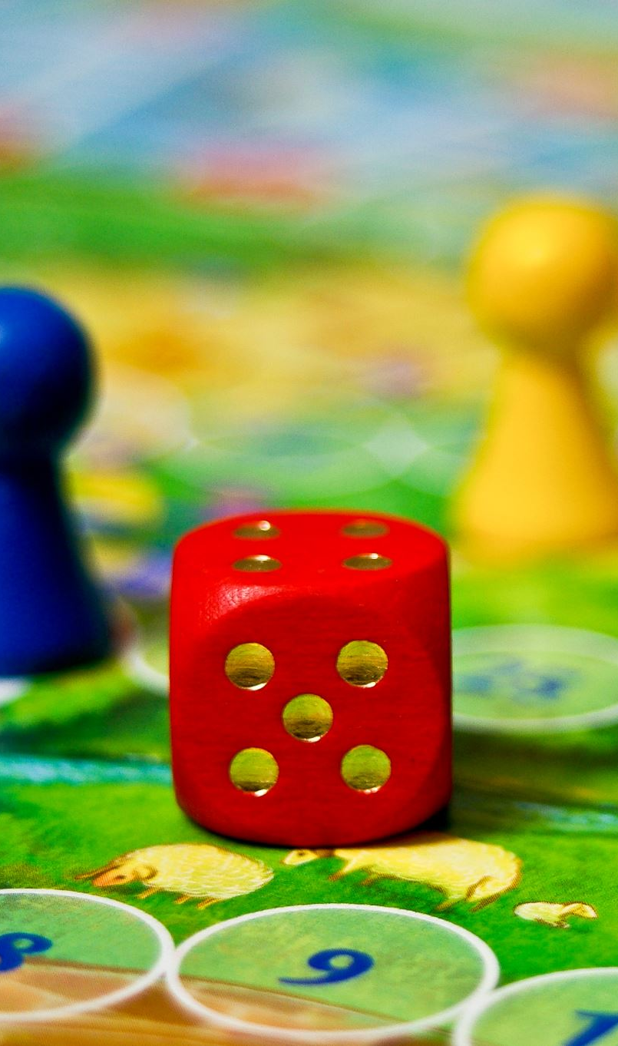
Project Goals
Our primary project goals were to create an engaging and functional Tic-Tac-Toe game application using Python and relevant libraries. We aimed to provide a seamless user experience for both human-to-human and human-to-computer gameplay."
Additionally, we set out to implement advanced features, such as computer opponent AI using the minimax algorithm, and visualize game statistics to enhance the gaming experience.

Slide 5
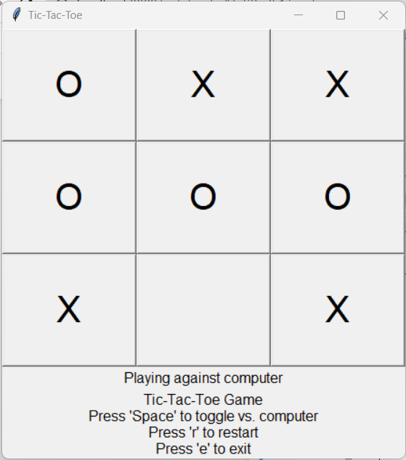
Game Interface
The heart of our project is the game interface, carefully designed to provide an intuitive and visually appealing experience. The interface includes a 3x3 game board, interactive buttons for player moves, and informative labels."
In this slide, you can see a screenshot of our game interface, showcasing its key elements that players interact with.

Slide 6
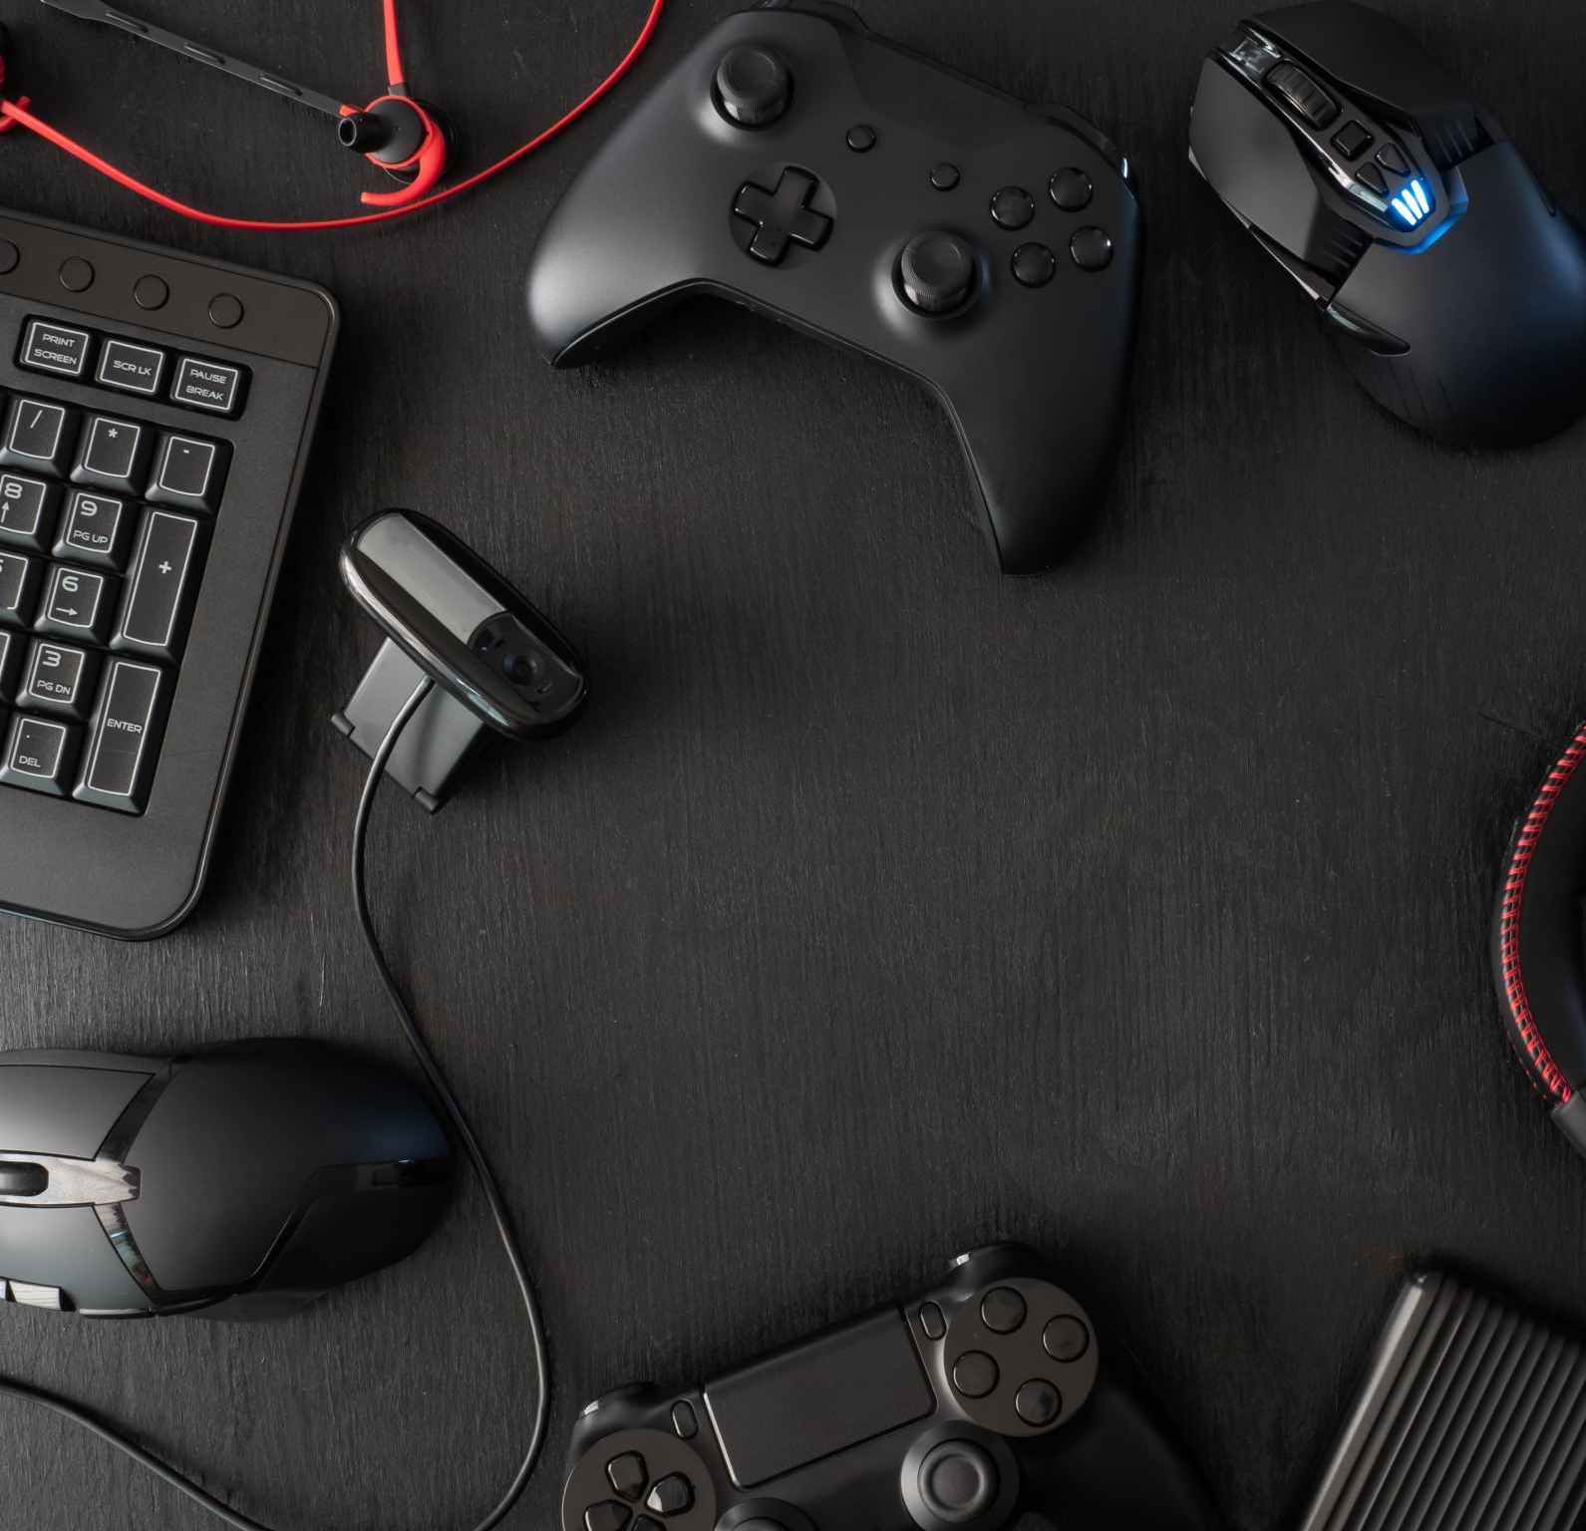
Game Instructions
Before diving into the gameplay, let's go over the game instructions to ensure an enjoyable experience for our players. Playing the game is straightforward:
Use the 'Space' key to toggle between playing against a human opponent or our AI-powered computer opponent.
2. During the game, press 'r' to restart the game and start fresh.
3. If you need to exit the game at any point, simply press 'e' to close the application.

Slide 7
Game Logic
Understanding the game logic is essential to master Tic-Tac-Toe.
Player moves: Each player (X and O) takes turns to place their symbol on the 3x3 grid, aiming to create a row, column, or diagonal of their symbol.
Win conditions: A player wins if they successfully create a row, column, or diagonal with their symbol.
N+Draws: If the entire board is filled, and no player achieves a win, the game ends in a draw.

Slide 8
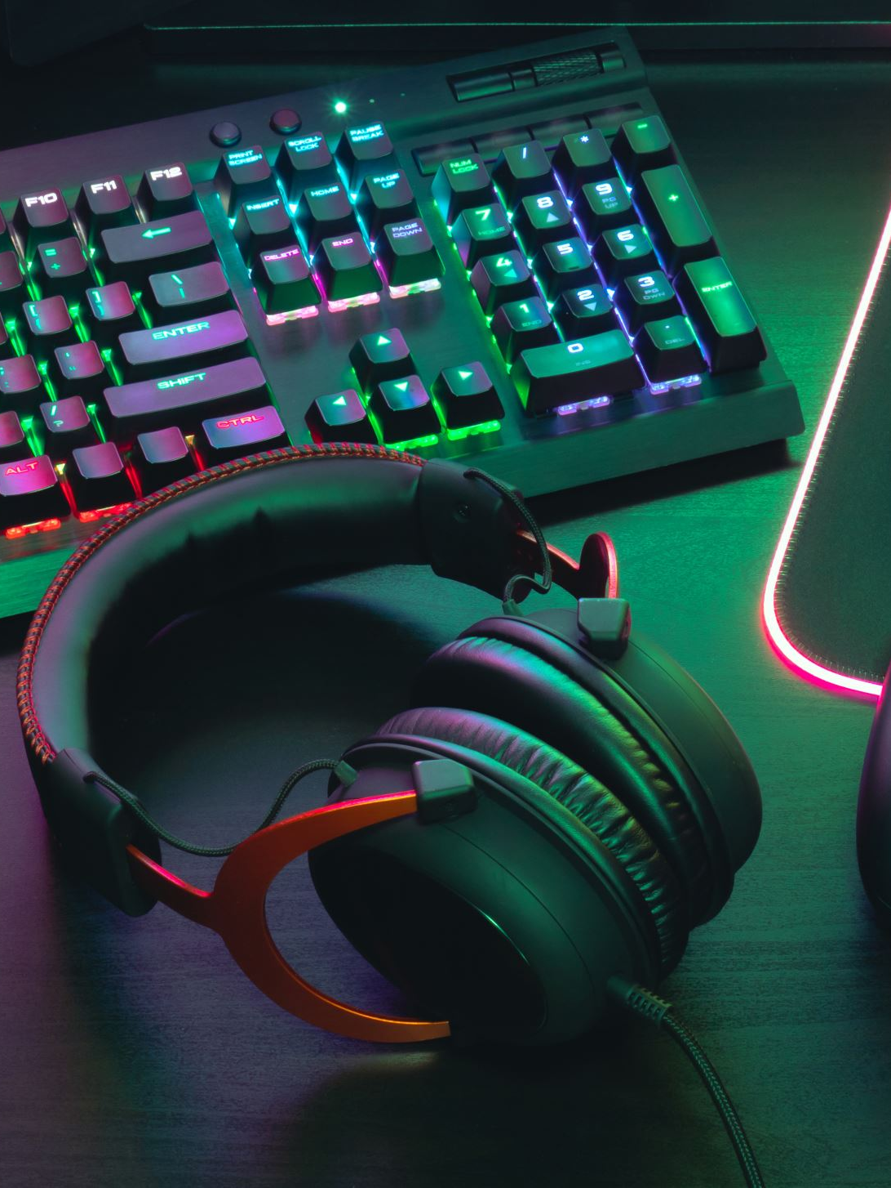
Player vs. Computer
One of the standout features of our game is the option to play against a computer opponent. Here's what you need to know:"
Player vs. Computer: By pressing the 'Space' key, players can toggle between playing against a human opponent or our AI-powered computer.
Computer's Turn: When playing against the computer, the AI uses the minimax algorithm to make strategic moves, providing a challenging experience.

Slide 9
Game Statistics
Our game keeps track of various statistics to provide insights into the gameplay. These statistics include:
Player X Wins: The number of games won by Player X.
Player O Wins: The number of games won by Player O.
Draws: The count of games that ended in a draw.
These statistics enhance the competitive aspect of the game and add an element of rivalry

Slide 10
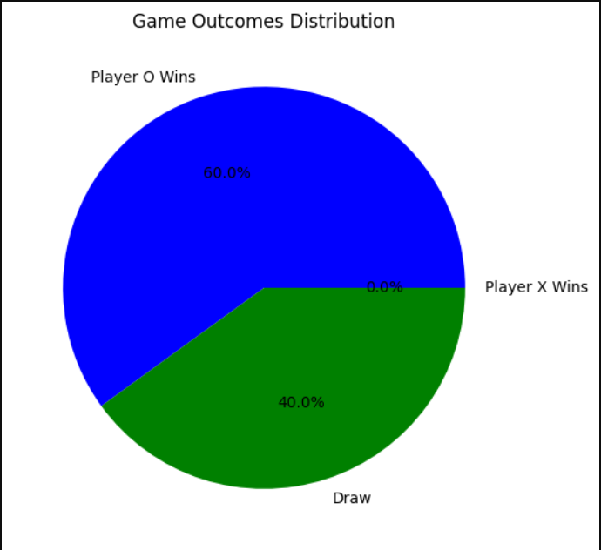
Visualization - Player Wins and Draws
We have visualized the game's outcomes to offer a clear view of player performance. The bar chart below illustrates:"
Player X Wins: Represented in red bars.
Player O Wins: Represented in blue bars.
Draws: Represented in green bars.

Slide 11
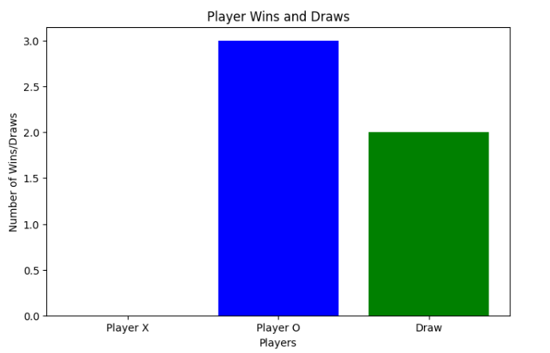
Visualization - Game Outcomes Distribution
To provide a holistic view of game outcomes, we've created a pie chart displaying the distribution of results:"
• Player X Wins: Shown in red.
Player O Wins: Shown in blue.
Draws: Shown in green.
This visualization helps players understand the balance between wins and draws in the game.

Slide 12
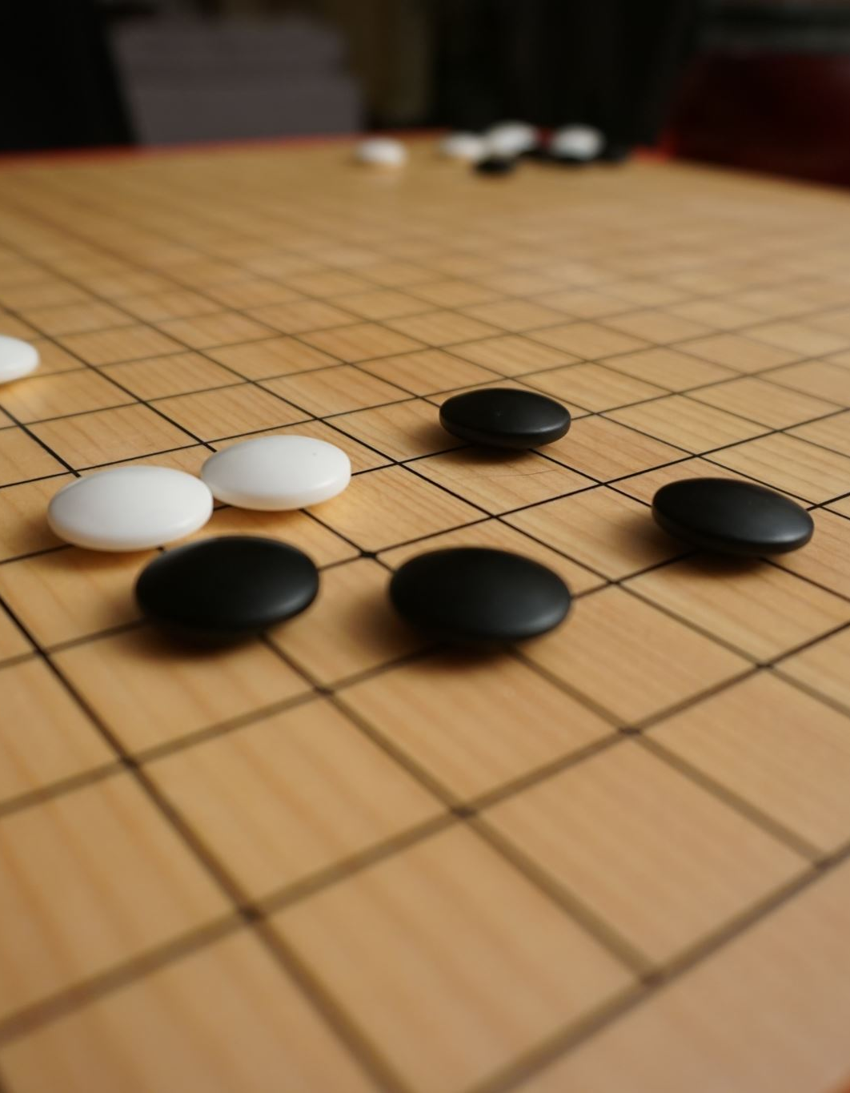
Game Flow - Player's Turn
Let's take a closer look at the game flow during a player's turn:
Player's Move: During their turn, players click on an empty cell on the game board to place their symbol ('X' or 'O').
Win Conditions: The game continuously checks for win conditions after each move, ensuring a fair and competitive experience.

Slide 13

Game Flow - Computer's Turn
When playing against our AI-powered computer, here's what happens during the computer's turn:
Minimax Algorithm: The computer utilizes the minimax algorithm to make strategic decisions."
Strategic Moves: The AI evaluates possible moves, aiming to maximize its chances of winning or forcing a draw.

Slide 14
Restart and Exit
For convenience and flexibility, our game offers the following options:
Restart: Press the 'r' key at any time to reset the game and begin a new round."
Exit: To close the application, simply press the 'e' key. This feature ensures a hassle-free gaming experience.

Slide 15

Project Deliverables
Our project encompasses several key deliverables that contribute to the successful implementation of the Tic-Tac-Toe game and enhance the user experience:
Source Code: We provide complete and well-documented Python source code for the Tic-Tac-Toe game. This includes the implementation of the Minimax algorithm for the AI player.
Executable Version: Users can access a runnable version of the game, allowing them to play Tic-Tac-Toe against the AI.
Graphic-Based User Interface: We've designed a simple, clear, and intuitive Graphic-based interface for the game, ensuring accessibility and an enjoyable gaming experience.

Slide 16
Conclusion
In conclusion, our Tic-Tac-Toe game project has been a journey of creativity, problem-solving, and collaborative effort.
We successfully developed a functional and enjoyable game that features a player-versus-computer mode with an AI opponent powered by the Minimax algorithm.
Our graphic-based user interface enhances accessibility and ensures an intuitive gaming experience.
This project allowed us to apply our programming skills, explore AI algorithms, and design user-friendly interfaces.

Slide 17

Thank you

